Slide 1
Credit Risk Models Cross-Validation – Is There Any Added Value?
Croatian Quants Day
Zagreb, June 6, 2014
Vili Krainz
vili.krainz@rba.hr
The views expressed during this presentation are solely those of the author

Slide 2
Introduction
Credit risk – The risk that one party to a financial contract will not perform the obligation partially or entirely (default)
Example – Bank loans
The need to assess the level of credit risk – credit risk rating models (credit scorecards)
Problem – to determine the functional relationship between obligor or loan characteristics X₁, X₂, ... , X_{n} (risk drivers) and binary event of default (0/1), in a form of latent variable of probability of default (PD)

Slide 3
Scorecard Development Process
Potential risk drivers – retail application example
Sociodemographic characteristics:
Age, marital status, residential status...
Economic characteristics:
Level of education, profession, years of work experience...
Financial characteristics:
Monthly income, monthly income averages...
Stability characteristics:
Time on current address, current job...
Loan characteristics:
Installment amount, approved limit amount, loan maturity...

Slide 4
Scorecard Development Process
Univariate analysis – analysis of each individual characteristic
Fine classing – division of numeric variables into a number (e.g. 20) of subgroups, analysis of general trend
Coarse classing – grouping into (2-5) larger classes to optimize predictiveness, with certain conditions (logical, monotonic trend, robust enough...)
Age | Bad rate
<30 | 3.47%
[30, 55] | 2.86%
>55 | 1.73%

Slide 5
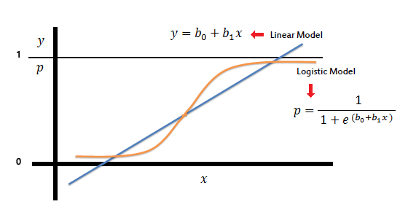
Scorecard Development Process
Multivariate analysis
Correlation between characteristics
Logit model – most widely used
Logistic regression (with selection process)

Slide 6
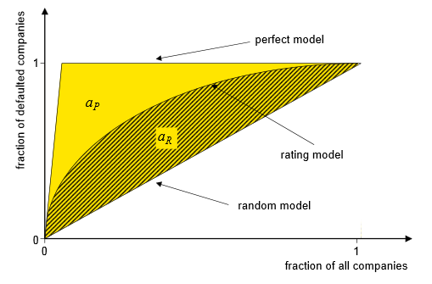
Scorecard Model Predictiveness
The goal of a scorecard model is to discriminate between the good and the bad applications
Predictivity is most commonly measured by Gini index (a.k.a Accuracy Ratio, Somers’ D)

Slide 7
Scorecard Model Cross-Validation
At model development start, the whole data sample is split randomly (70/30, 75/25, 80/20...)
The bigger sample is used for model development, while the smaller sample is used for cross-validation
Model’s predictive power (Gini index) is measured on the independent, validation sample
Done to avoid overfitting
The predictive power shouldn’t be much lower on the validation sample than it is on the development – that’s when the validation is considered successful

Slide 8
What if validation fails?
Is it possible if everything is done „by the book”?
Does that mean that:
Something was done wrong in model development process?
The sample is not suitable for modeling at all?
The process needs to be repeated?

Slide 9
Monte Carlo Simulations
Real (masked) publicly available retail application data (Thomas, L., Edelman, D. and Crook, J., 2002. Credit Scoring and Its Applications. Philadelphia: SIAM.)
1000 simulations of model development process in R
Each time stratified random sampling (75/25) was done (on several characteristics, including the target variable – default indicator)
Fine classing for the numeric variables
Coarse classing all the variables using the code that simulates modeler’s decisions
Stepwise logistic regression using AIC
Measuring Gini index on development and validation sample
Pre-selection of characteristics for the business logic and correlation
One reference model was built on whole data sample

Slide 10
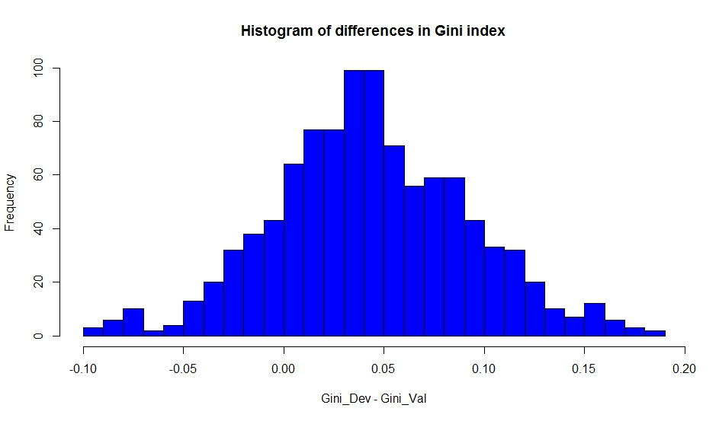
Results
In 12.5% of cases we get a difference bigger than 0.1
Pearson’s chi-square test – all characteristics of all 1000 samples representative at 5% significance level

Slide 11
Results
Idea: Compare the scores from each simulation model to reference model (on the whole sample) and relate to differences in Gini
If there is a strong connection – we strive to get a model similar to the reference model
Wilcoxon paired (signed rank) test
H₀: median difference between the pairs is zero
H₁: median difference is not zero.
Basically, the alternative hypothesis states that one model results in systematically different (higher or lower) scores than the other

Slide 12
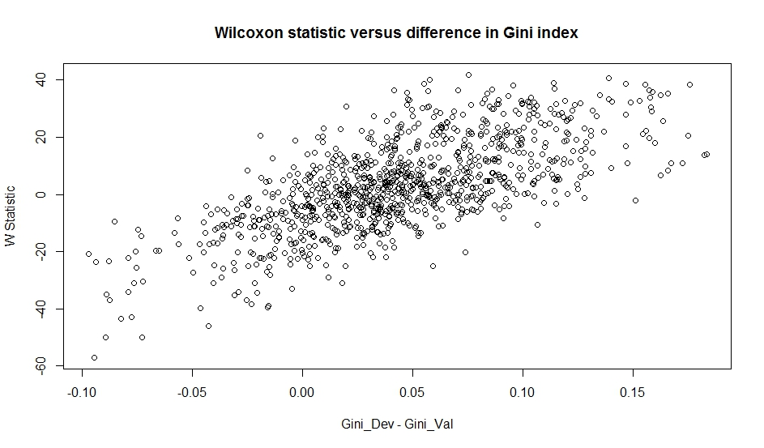
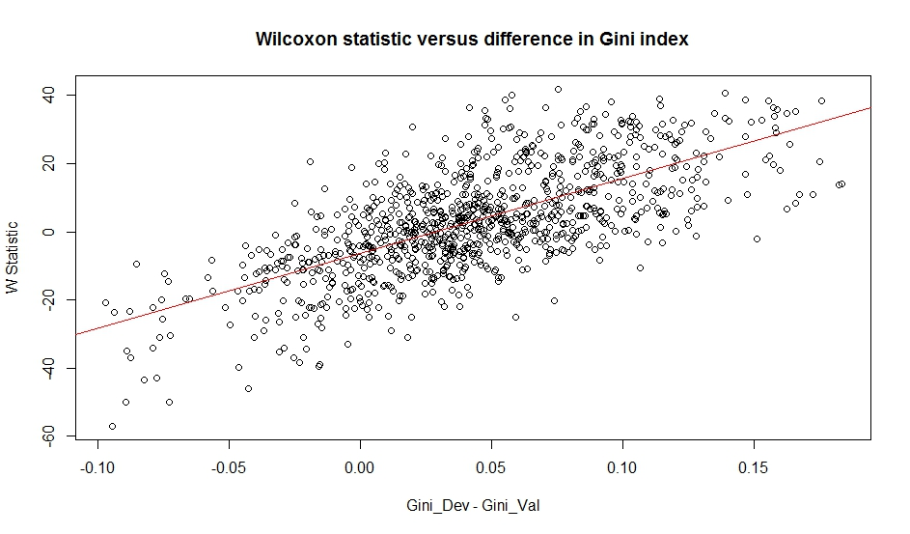
Results
Correlation: 0.68

Slide 13
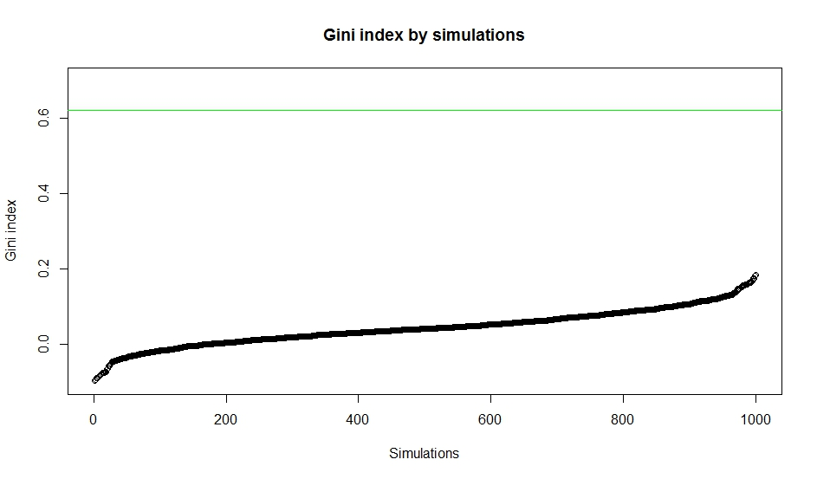
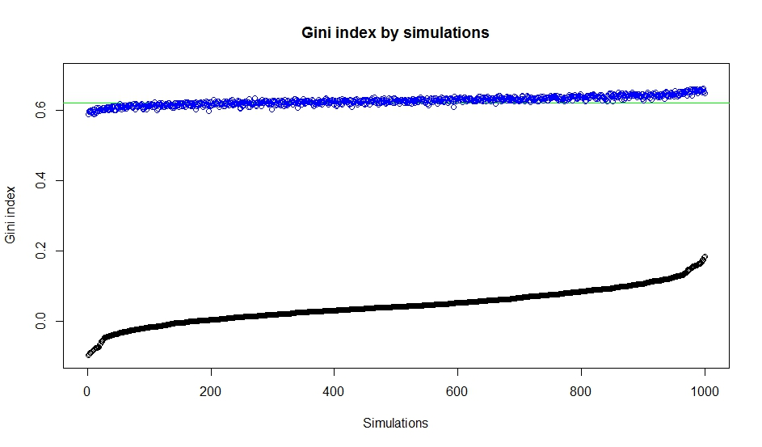
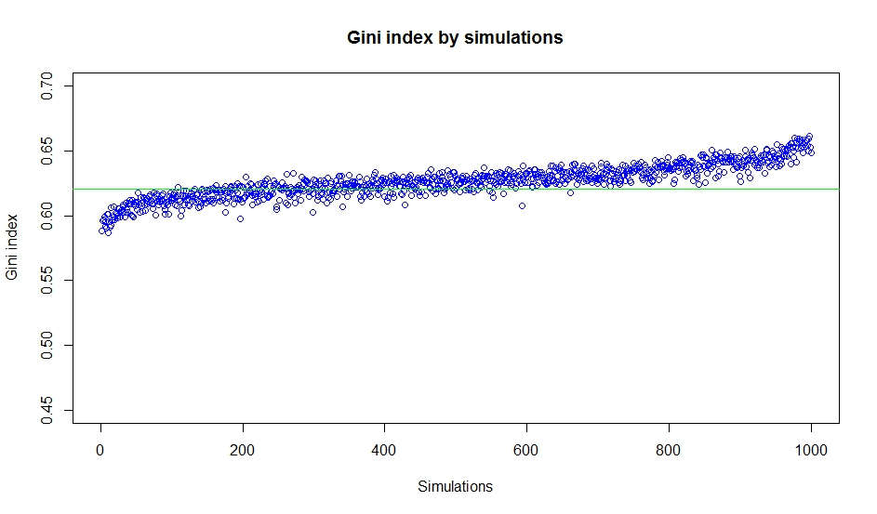
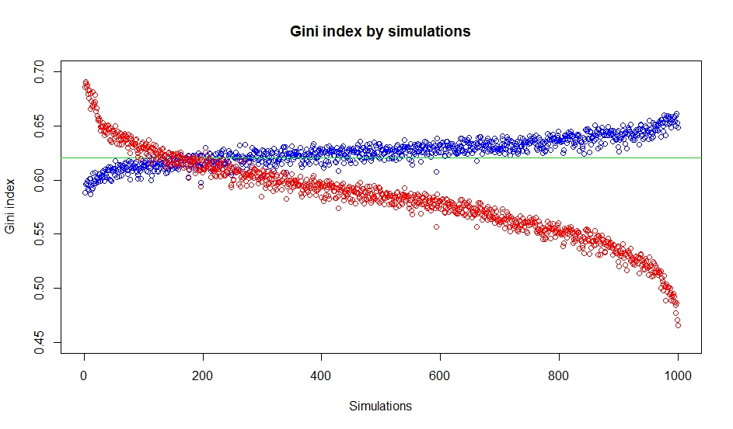
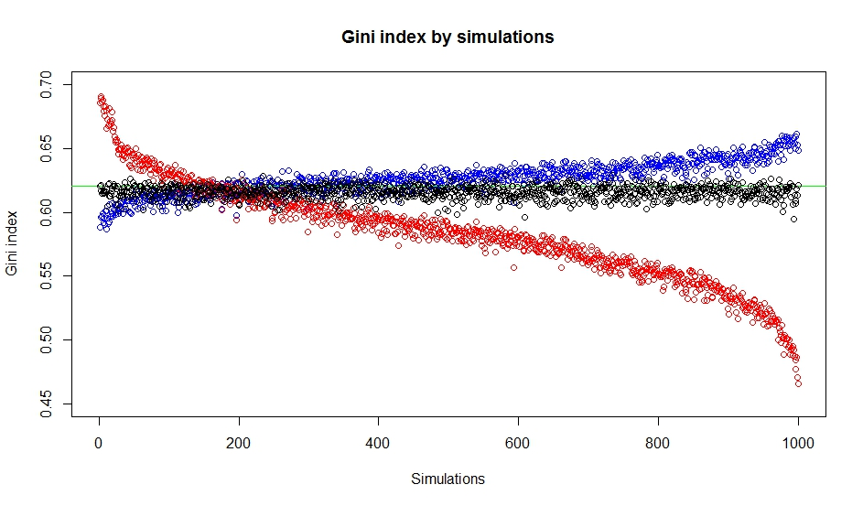
Results

Slide 14
From The Simulations...
Regardless of a modeling job done right, validation can fail by chance
We like to have Gini index on the development sample “similar” to the one on the validation sample – we tend to get the model that is more similar to the reference model – why not develop on the whole sample in the first place?
Regardless of validation results and difference in Gini, predictive power on the whole data sample does not vary too much

Slide 15
Instead Of A Conclusion...
Does this method of cross-validation bring any added value?
It may be more important to check whether all the modeling steps have been performed carefully and properly, and that best practices are used, in order to avoid overfitting
Can any cross-validation method can offer real assurance or does the only real test come with future data?

Slide 16
Thank You!
vili.krainz@rba.hr

