Slide 1
New liquidity measurements – LCR&NSFR
Zagreb, 11.05.2012

Slide 2

Definition:
Liquidity- ability to meet obligations when they come due without incurring unacceptable losses

Slide 3
Liquidity was major problem during this crises for many credit institutions
The result is that most banks now try to forecast their liquidity requirements
Banking regulators also view liquidity as a major concern and that is why this two measurements were developed
Quantitative measures of liquidity are being implemented, liquidity isn’t any more only a gut feeling

Slide 4

LCR
Liquidity coverage ratio - designed to ensure that financial institutions have the necessary assets on hand to ride out short-term liquidity disruptions.

Slide 5

NSFR
Net stable funding ratio - requires a minimum amount of funding that is expected to be stable over a one year time horizon based on liquidity risk factors assigned to assets and off-balance sheet liquidity exposures.

Slide 6
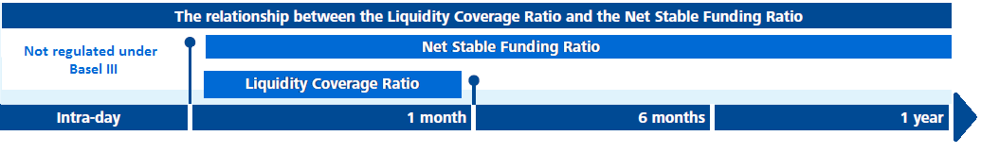
Characteristics of both report
assumptions set by regulators to model stress scenario
differ base on product type and other characteristics
assumptions for deposits also differ based on counterparty (whether it is retail, corporate…) and whether we have operational relationship with a client

Slide 7
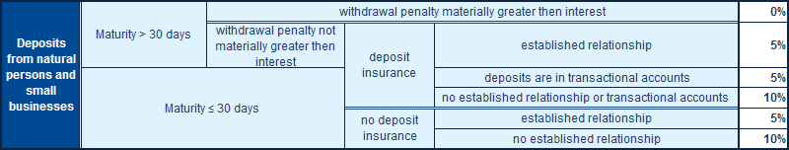
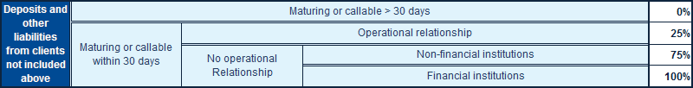
Deposits:
Whether client has relationship/operational relationship with bank or not has big influence on run-off rate.
Currently definition of relationship is left on credit institutions to define and presence of relationship should reflect stability of the deposit – gives us opportunity to develop our own models.

Slide 8
Deposits:
Relationship → stable deposit; withdrawal of these deposits should be highly unlikely
-most important issue in new LQ measurements

Slide 9
Deposits:
Retail-with operation relationship
Retail deposits
Retail-no operation relationship
Corp-with operation relationship
Corp deposits
Corp-no operation relationship
Deposits
Model done based on historical data
Other deposits

Slide 10
Model:
Predictor variables (X) :
Existing loan
Incomes
Trans. accounts
Monthly turnovers in last 12 months
.....
Respons variable (Y) :
Stability flag:
1-stable
0-less stable
Binary
Response variable has only two possible outcomes so we will use logistic regression as a model.

Slide 11
Model:
log[P{y=1}/(1-P{y=1})] is called logistic transformation or logit
It transforms binary variable into continuous one:
Note: response variable is no longer y but P{y=1}

Slide 12

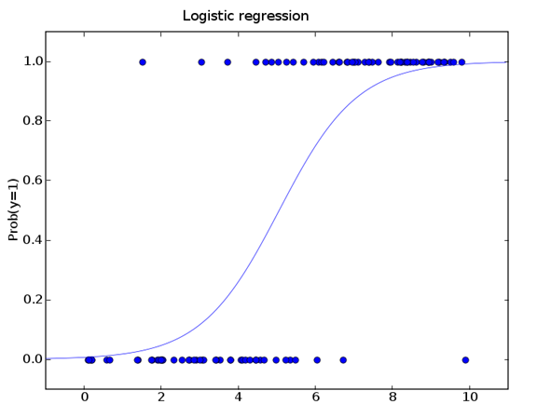
Model:
Formula that expresses the probability of success directly:

Slide 13
Main concern is to make good model to differential stable and less stable deposits in retail. This model will have influence on the entire bank (e.g. pricing of deposits, liquidity ratios, interest rates for clients, regulatory requirements…)

Slide 14
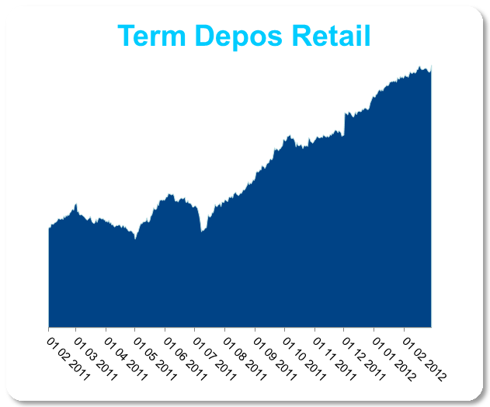
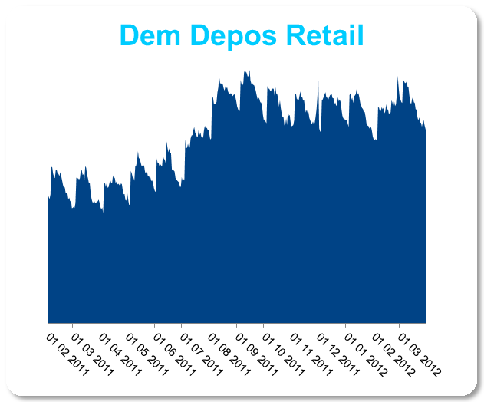
Modeling amount of deposits:
One more very important issue is to forecast volume of the deposits

Slide 15
Thanks for the attention!

