Slide 1
CHARACTERIZATIONS OF GENERALIZED POLES BY POLE
CANCELLATION FUNCTIONS OF HIGHER ORDER
MUHAMED BOROGOVAC AND ANNEMARIE LUGER
http://arxiv.org/abs/1309.3677

Slide 2
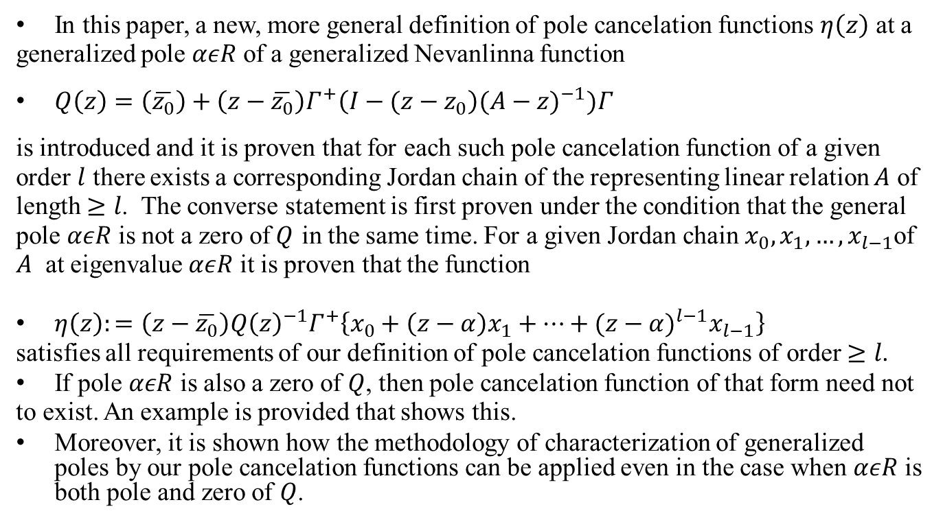
Abstract
In this paper, a new, more general definition of pole cancelation functions $η\left(z\right)$ at a generalized pole $αεR$ of a generalized Nevanlinna function
$Q\left(z\right)=\left(\overline{z_{0}}\right)+\left(z−\overline{z_{0}}\right)Γ^{+}\left(I−(z−z_{0}\right){(A−z)}^{−1})Γ$
is introduced and it is proven that for each such pole cancelation function of a given order $l$ there exists a corresponding Jordan chain of the representing linear relation $A$ of length $≥l$. The converse statement is first proven under the condition that the general pole $αεR$ is not a zero of$Q$ in the same time. For a given Jordan chain $x_{0}, x_{1}, …,x_{l−1}$of $A$ at eigenvalue $αεR$ it is proven that the function
$η\left(z\right):=\left(z−\overline{z_{0}}\right){Q\left(z\right)}^{−1}Γ^{+}\left\{x_{0}+\left(z−α\right)x_{1}+…+{(z−α)}^{l−1}x_{l−1}\right\}$
satisfies all requirements of our definition of pole cancelation functions of order $≥l$.
If pole $αεR$ is also a zero of $Q$, then pole cancelation function of that form need not to exist. An example is provided that shows this.
Moreover, it is shown how the methodology of characterization of generalized poles by our pole cancelation functions can be applied even in the case when $αεR$ is both pole and zero of $Q$.

Slide 3
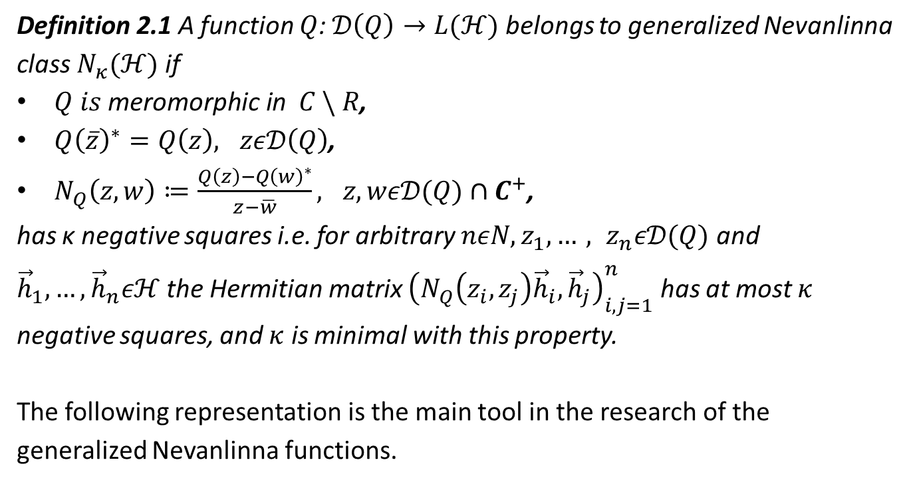

Generalized Nevanlinna class $N_{κ}(ℋ)$
Definition 2.1 A function $Q$: $𝒟\left(Q\right)→L(ℋ)$ belongs to generalized Nevanlinna class $N_{κ}(ℋ)$ if
$Q is \text{meromorphic} \text{in} C \backslash R$,
${Q\left(\overline{z}\right)}^{∗}=Q\left(z\right), zε𝒟\left(Q\right)$,
$N_{Q}\left(z,w\right)≔\frac{Q\left(z\right)−{Q\left(w\right)}^{∗}}{z−\overline{w}}, z, wε𝒟(Q)∩C^{+}$,
has κ negative squares i.e. for arbitrary $nεN, z_{1}, …, z_{n}ε𝒟(Q)$ and ${\vec{h}}_{1}, …,{\vec{h}}_{n}εℋ$ the Hermitian matrix ${\left(N_{Q}\left(z_{i},z_{j}\right){\vec{h}}_{i},{\vec{h}}_{j}\right)}_{i,j=1}^{n}$ has at most $κ$ negative squares, and $κ$ is minimal with this property.
The following representation is the main tool in the research of the generalized Nevanlinna functions.

Slide 4
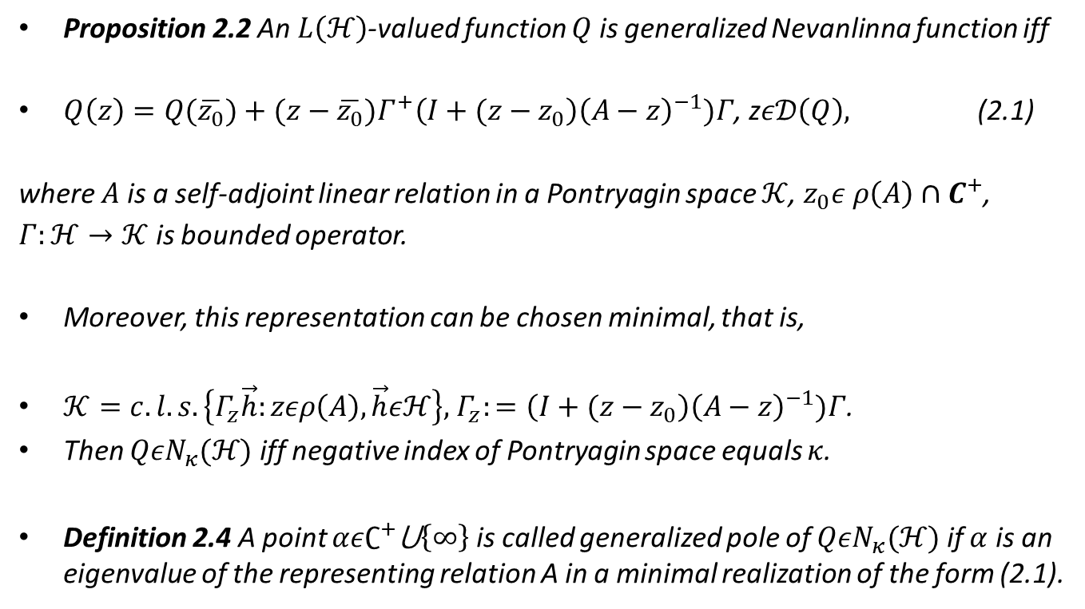
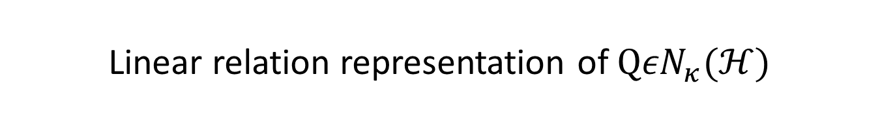
Linear relation representation of $Q{εN}_{κ}(ℋ)$
Proposition 2.2 An $L\left(ℋ\right)$-valued function $Q$ is generalized Nevanlinna function iff
$Q\left(z\right)=Q(\overline{z_{0}})+(z−\overline{z_{0}})Γ^{+}\left(I+(z−z_{0}\right){\left(A−z\right)}^{−1})Γ$, z$ε𝒟\left(Q\right),$ (2.1)
where $A$ is a self-adjoint linear relation in a Pontryagin space $𝒦$, $z_{0}ε ρ\left(A\right)$ $∩C^{+}$, $Γ:ℋ→𝒦$ is bounded operator.
Moreover, this representation can be chosen minimal, that is,
$𝒦=c.l.s.\left\{Γ_{z}\vec{h}:zερ\left(A\right),\vec{h}εℋ\right\},$ $Γ_{z}:=\left(I+(z−z_{0}\right){\left(A−z\right)}^{−1})Γ$.
Then $Q{εN}_{κ}(ℋ)$ iff negative index of Pontryagin space equals $κ$.
Definition 2.4 A point $αε∁^{+}$⋃$\left\{∞\right\}$ is called generalized pole of $Q{εN}_{κ}(ℋ)$ if $α$ is an eigenvalue of the representing relation A in a minimal realization of the form (2.1).

Slide 5
History of the problem
The problem of analytic characterization of the algebraic eigen-space structure of the representing operator A in terms of Q has been around from time when generalized Nevanlinna functions have been introduced, around 40 years ago, by M. G. Krein and H. Langer.
For scalar generalized Nevanlinna functions, analytic characterization of the degree of non-positivity was proven in 1986 by H. Langer.
Analytic characterization of the whole chain was proven in 2006 by S. Hassi and A. Luger .

Slide 6
Pole cancelation function (PCF)
For operator generalized Nevanlinna functions the appropriate tool are so-called pole cancellation functions (PCFs).
Solving the problem of characterization of generalized poles requires finding appropriate definition of PCF. It is a very big part of the solution.
Several partial results have been proven by H. Langer, M. Borogovac, A. Dijksma, H. de Snoo, A. Luger.
For example, characterization of eigen-vectors of embedded poles and characterization of algebraic eigen-space structure of isolated singularities were proven in 1988 and 1991 by H. Langer and M. Borogovac .

Slide 7
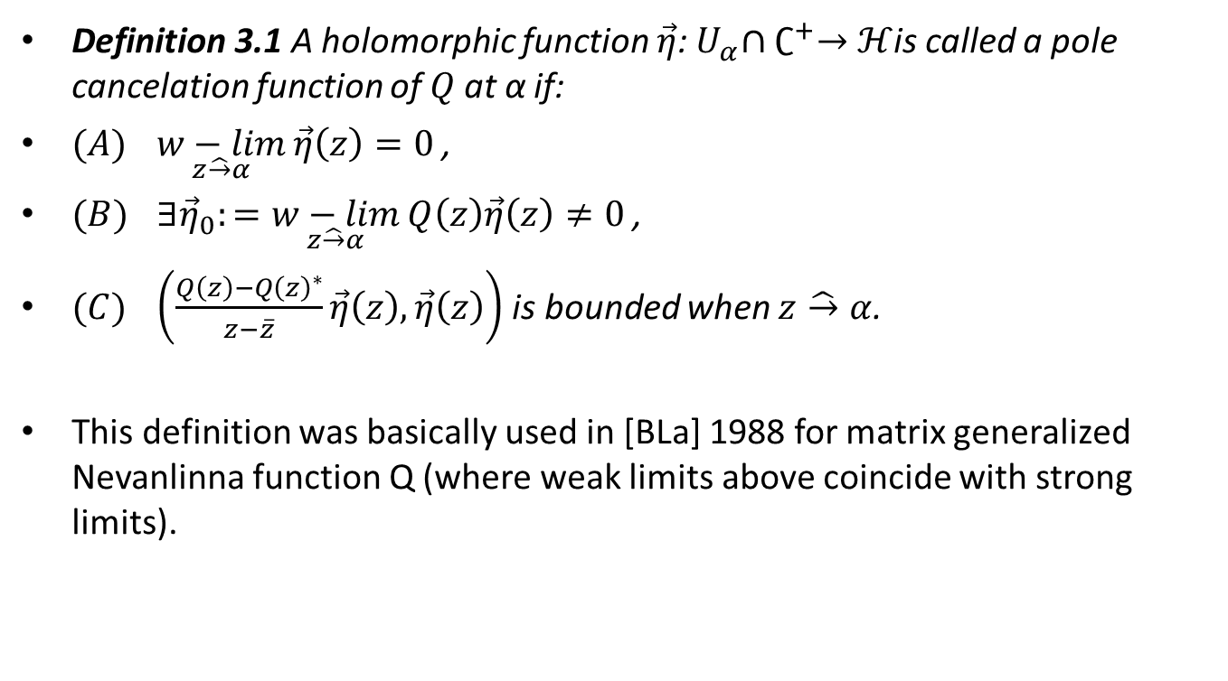
Definition PCF
Definition 3.1 A holomorphic function $\vec{η}$:${ U}_{α}∩∁^{+}→ℋ$is called a pole cancelation function of $Q$at α if:
$(A)$ $\underset{z\hat{→}α}{w−lim}{\vec{η}\left(z\right)=0}$ ,
$(B)$ $∃{\vec{η}}_{0}:=\underset{z\hat{→}α}{w−lim}{Q\left(z\right)\vec{η}\left(z\right)≠0}$ ,
$(C)$ $\left(\frac{Q\left(z\right)−{Q\left(z\right)}^{∗}}{z−\overline{z}}\vec{η}\left(z\right),\vec{η}\left(z\right)\right)$ is bounded when $z\hat{→}α$.
This definition was basically used in [BLa] 1988 for matrix generalized Nevanlinna function Q (where weak limits above coincide with strong limits).

Slide 8
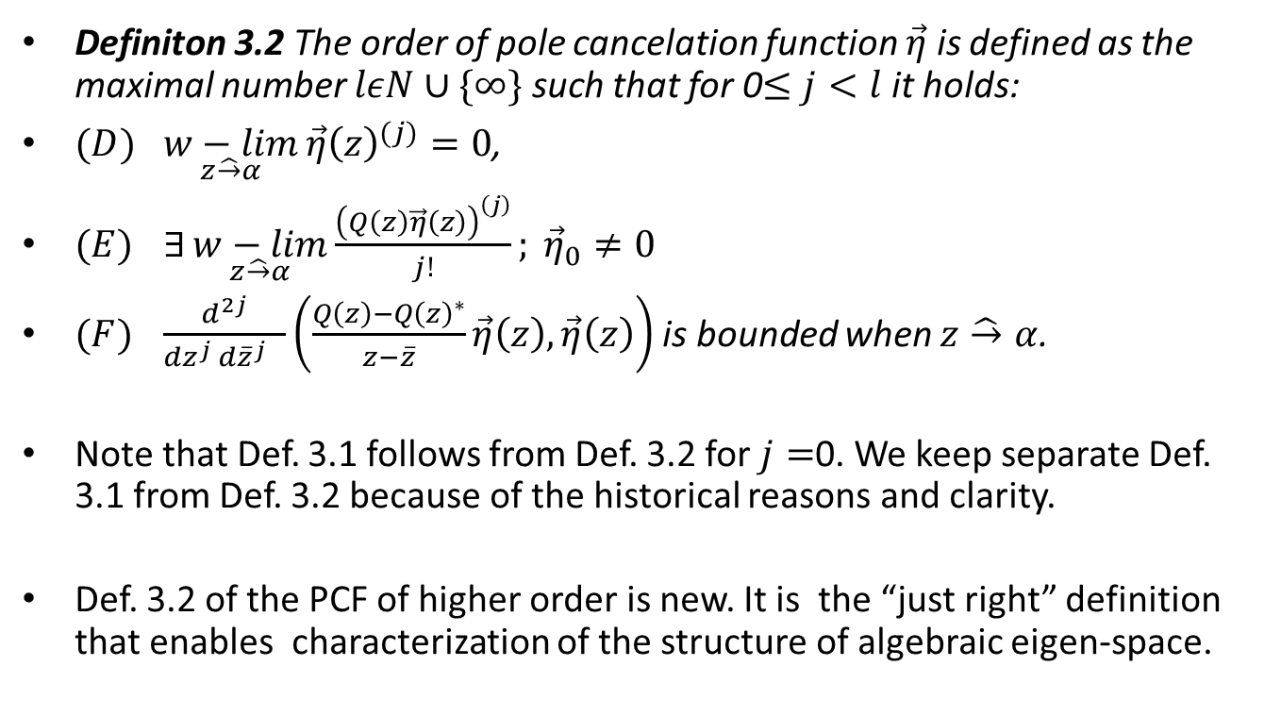
Definition PCF of higher order
Definiton 3.2 The order of pole cancelation function $\vec{η}$ is defined as the maximal number $lεN∪\{∞\}$ such that for 0$≤j<l$ it holds:
$(D)$ $\underset{z\hat{→}α}{w−lim}{{\vec{η}\left(z\right)}^{(j)}}=0$,
$(E)$ $∃\underset{z\hat{→}α}{w−lim}{\frac{{\left(Q\left(z\right)\vec{η}\left(z\right)\right)}^{\left(j\right)}}{j!}; {\vec{η}}_{0}≠0 }$
$(F)$ $\frac{d^{2j}}{{dz}^{j} {d\overline{z}}^{j} }\left(\frac{Q\left(z\right)−{Q\left(z\right)}^{∗}}{z−\overline{z}}\vec{η}\left(z\right),\vec{η}\left(z\right)\right)$ is bounded when $z\hat{→}α$.
Note that Def. 3.1 follows from Def. 3.2 for $j=$0. We keep separate Def. 3.1 from Def. 3.2 because of the historical reasons and clarity.
Def. 3.2 of the PCF of higher order is new. It is the “just right” definition that enables characterization of the structure of algebraic eigen-space.

Slide 9
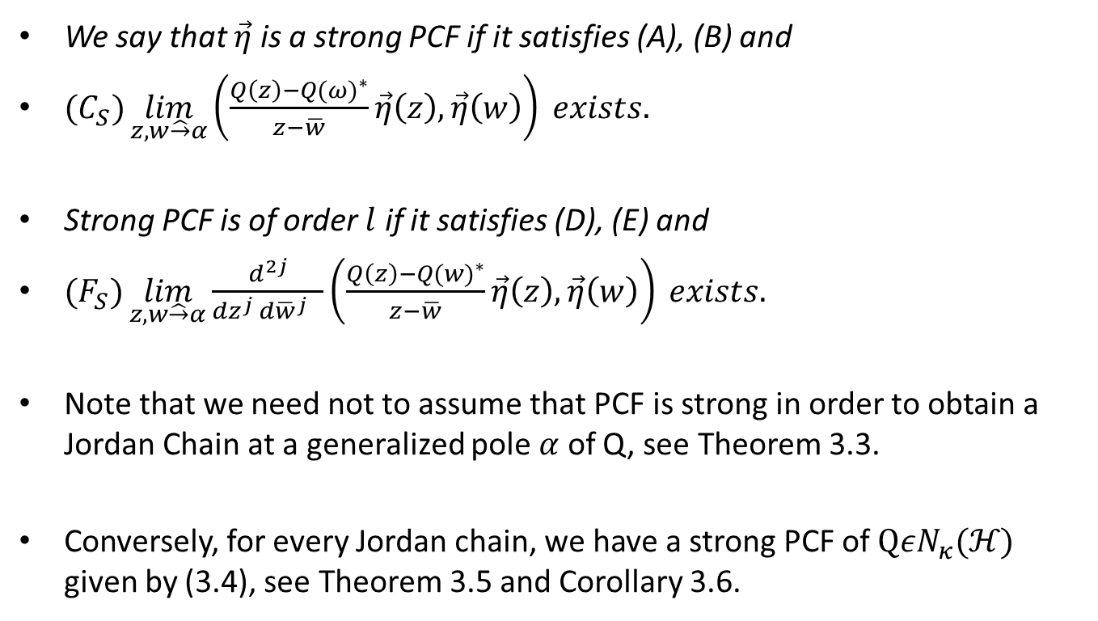
Strong PCF
We say that $\vec{η}$ is a strong PCF if it satisfies (A), (B) and
$(C_{S})\lim_{z,w\hat{→}α}\left(\frac{Q\left(z\right)−{Q(ω)}^{∗}}{z−\overline{w}}\vec{η}\left(z\right),\vec{η}\left(w\right)\right) exists.$
Strong PCF is of order $l$ if it satisfies (D), (E) and
$(F_{S})\lim_{z,w\hat{→}α}\frac{d^{2j}}{{dz}^{j} {d\overline{w}}^{j} }\left(\frac{Q\left(z\right)−{Q(w)}^{∗}}{z−\overline{w}}\vec{η}\left(z\right),\vec{η}\left(w\right)\right) exists.$
Note that we need not to assume that PCF is strong in order to obtain a Jordan Chain at a generalized pole $α$ of Q, see Theorem 3.3.
Conversely, for every Jordan chain, we have a strong PCF of $Q{εN}_{κ}(ℋ)$ given by (3.4), see Theorem 3.5 and Corollary 3.6.

Slide 10
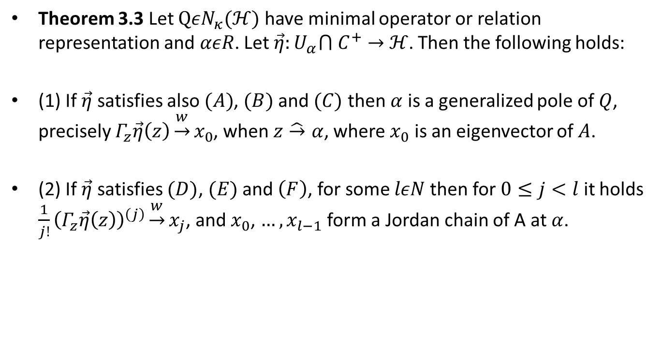
Jordan chains by means of PCFs
Theorem 3.3 Let $Q{εN}_{κ}(ℋ)$ have minimal operator or relation representation and $αεR$. Let $\vec{η}:U_{α}⋂ C^{+}→$ $ℋ$. Then the following holds:
(1) If $\vec{η}$ satisfies also $(A)$, $(B)$ and $(C)$ then $α$ is a generalized pole of $Q$, precisely $Γ_{z}\vec{η}\left(z\right)\underset{→}{w}x_{0}$, when $z\hat{→}α$, where $x_{0}$ is an eigenvector of $A$.
(2) If $\vec{η}$ satisfies $(D)$, $(E)$ and $\left(F\right)$, for some $lεN$ then for $0≤j<l$ it holds $\frac{1}{j!}{\left(Γ_{z}\vec{η}\left(z\right)\right)}^{\left(j\right)}\underset{→}{w}x_{j}$, and $x_{0}$, $…,x_{l−1}$ form a Jordan chain of A at $α$.

Slide 11
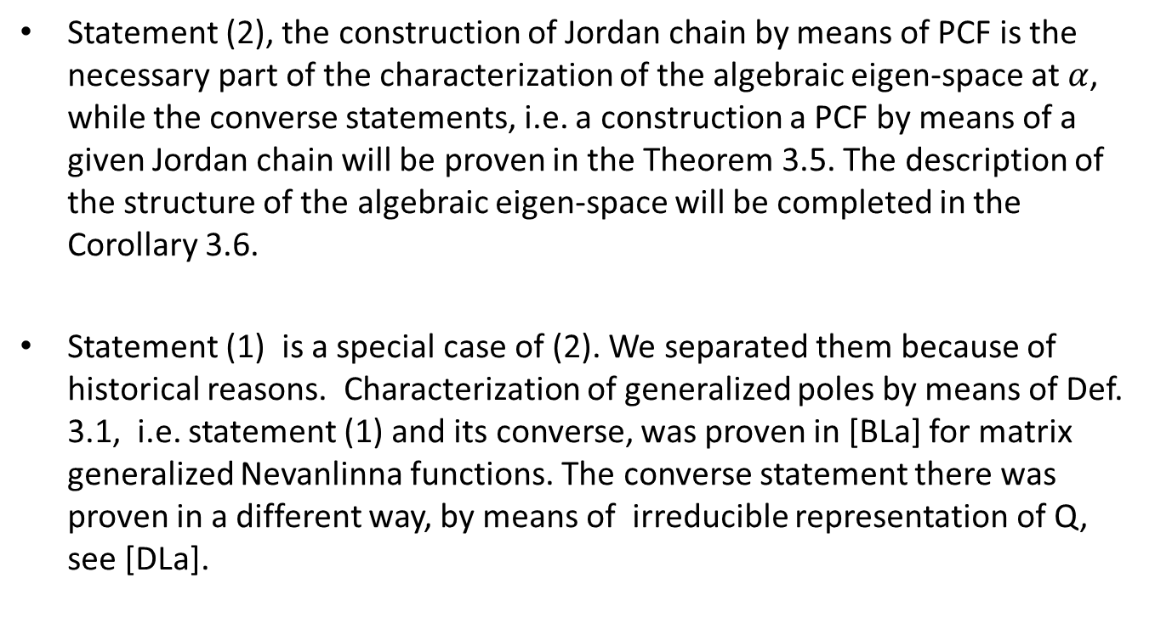
Remarks about Theorem 3.3
Statement (2), the construction of Jordan chain by means of PCF is the necessary part of the characterization of the algebraic eigen-space at $α$, while the converse statements, i.e. a construction a PCF by means of a given Jordan chain will be proven in the Theorem 3.5. The description of the structure of the algebraic eigen-space will be completed in the Corollary 3.6.
Statement (1) is a special case of (2). We separated them because of historical reasons. Characterization of generalized poles by means of Def. 3.1, i.e. statement (1) and its converse, was proven in [BLa] for matrix generalized Nevanlinna functions. The converse statement there was proven in a different way, by means of irreducible representation of Q, see [DLa].

Slide 12

Basic formulae used in the proofs
For $z, z_{0}, wερ\left(A\right)$ and $αεσ_{p}(A)$ we have:
$Γ_{z}:=\left(I+(z−z_{0}\right){\left(A−z\right)}^{−1})Γ$,
$Γ_{w}:=\left(I+(w−z\right){\left(A−w\right)}^{−1})Γ_{z}$, (2.2)
$Γ_{w}^{+}Γ_{z}$=${Γ_{\overline{z}}}^{+}Γ_{\overline{w}}=\frac{Q\left(z\right)−{Q\left(w\right)}^{∗}}{z−\overline{w}}$, (2.3)
${\left(A−z_{0}\right)}^{−1}Γ_{z}=\frac{1}{z−z_{0}}\left(Γ_{z}−Γ_{z_{0}}\right)$. (2.4)

Slide 13
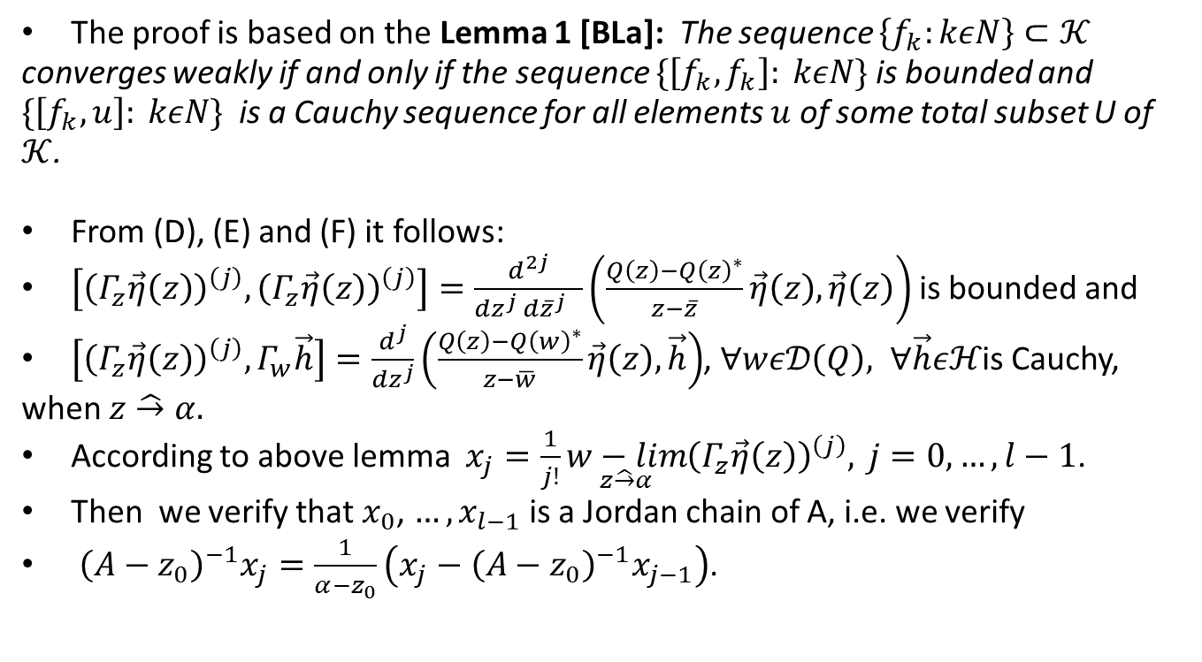
Hint of the proof of Theorem 3.3
The proof is based on the Lemma 1 [BLa]: The sequence $\left\{f_{k}:kεN\right\}⊂𝒦$ converges weakly if and only if the sequence $\{\left[f_{k},f_{k}\right]: kεN\}$ is bounded and $\{\left[f_{k},u\right]: kεN\}$ is a Cauchy sequence for all elements $u$ of some total subset U of $𝒦$.
From (D), (E) and (F) it follows:
$\left[{\left(Γ_{z}\vec{η}\left(z\right)\right)}^{\left(j\right)},{\left(Γ_{z}\vec{η}\left(z\right)\right)}^{\left(j\right)}\right]=\frac{d^{2j}}{{dz}^{j} {d\overline{z}}^{j} }\left(\frac{Q\left(z\right)−{Q\left(z\right)}^{∗}}{z−\overline{z}}\vec{η}\left(z\right),\vec{η}\left(z\right)\right)$ is bounded and
$\left[{\left(Γ_{z}\vec{η}\left(z\right)\right)}^{\left(j\right)},Γ_{w}\vec{h}\right]=\frac{d^{j}}{{dz}^{j}}\left(\frac{Q\left(z\right)−{Q\left(w\right)}^{∗}}{z−\overline{w}}\vec{η}\left(z\right),\vec{h}\right)$, $∀wε𝒟\left(Q\right), ∀\vec{h}εℋ$is Cauchy, when $z\hat{→}α.$
According to above lemma $x_{j}=\frac{1}{j!}\underset{z\hat{→}α}{w−lim}{{\left(Γ_{z}\vec{η}\left(z\right)\right)}^{\left(j\right)},} j=0, …, l−1$.
Then we verify that $x_{0}$, $…,x_{l−1}$ is a Jordan chain of A, i.e. we verify
${\left(A−z_{0}\right)}^{−1}x_{j}=\frac{1}{α−z_{0}}\left(x_{j}−{\left(A−z_{0}\right)}^{−1}x_{j−1}\right)$.

Slide 14
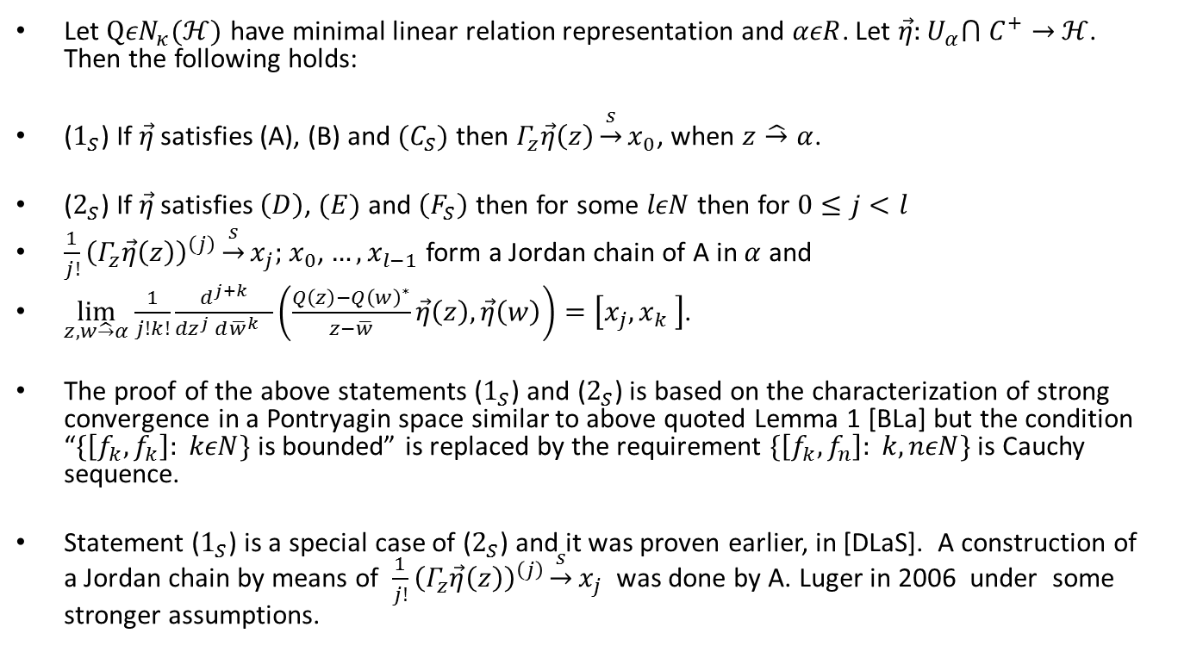
Remark about Strong PCF
Let $Q{εN}_{κ}(ℋ)$ have minimal linear relation representation and $αεR$. Let $\vec{η}:U_{α}⋂ C^{+}→$ $ℋ$. Then the following holds:
($1_{S}$) If $\vec{η}$ satisfies (A), (B) and $(C_{S})$ then $Γ_{z}\vec{η}\left(z\right)\underset{→}{s}x_{0}$, when $z\hat{→}α$.
($2_{S}$) If $\vec{η}$ satisfies $\left(D\right)$, $(E)$ and $\left(F_{S}\right)$ then for some $lεN$ then for $0≤j<l$
$\frac{1}{j!}{\left(Γ_{z}\vec{η}\left(z\right)\right)}^{\left(j\right)}\underset{→}{s}x_{j};$ $x_{0}$, $…,x_{l−1}$ form a Jordan chain of A in $α$ and
$\lim_{z,w\hat{→}α}\frac{1}{j!k!}{\frac{d^{j+k}}{{dz}^{j} {d\overline{w}}^{k} }\left(\frac{Q\left(z\right)−{Q\left(w\right)}^{∗}}{z−\overline{w}}\vec{η}\left(z\right),\vec{η}\left(w\right)\right)}=\left[x_{j},x_{k} \right]$.
The proof of the above statements ($1_{S}$) and ($2_{S}$) is based on the characterization of strong convergence in a Pontryagin space similar to above quoted Lemma 1 [BLa] but the condition “$\{\left[f_{k},f_{k}\right]: kεN\}$ is bounded” is replaced by the requirement $\{\left[f_{k},f_{n}\right]: k,nεN\}$ is Cauchy sequence.
Statement ($1_{S}$) is a special case of ($2_{S}$) and it was proven earlier, in [DLaS]. A construction of a Jordan chain by means of $\frac{1}{j!}{\left(Γ_{z}\vec{η}\left(z\right)\right)}^{\left(j\right)}\underset{→}{s}x_{j}$ was done by A. Luger in 2006 under some stronger assumptions.

Slide 15
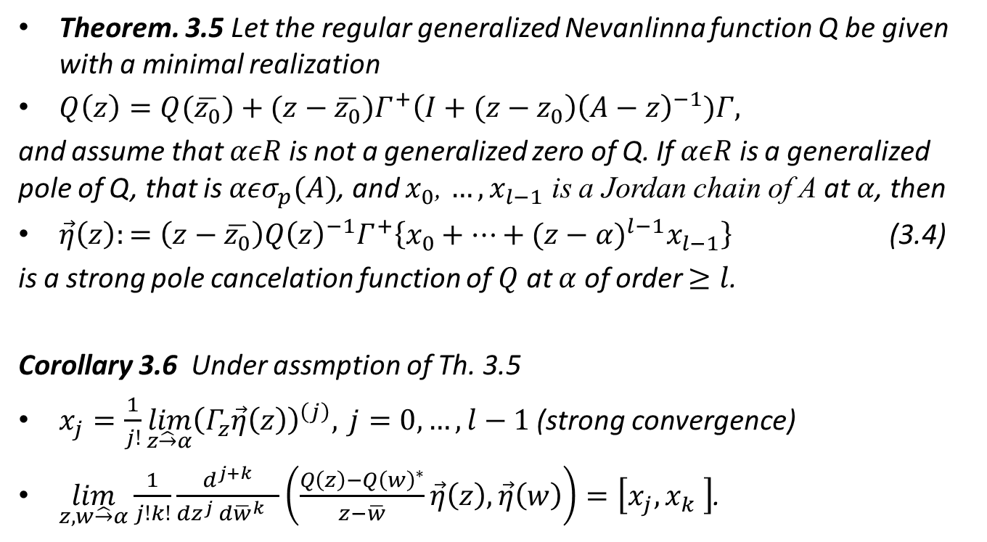
Pole cancellation functions by means of Jordan chains.
Theorem. 3.5 Let the regular generalized Nevanlinna function Q be given with a minimal realization
$Q\left(z\right)=Q(\overline{z_{0}})+(z−\overline{z_{0}})Γ^{+}\left(I+(z−z_{0}\right){\left(A−z\right)}^{−1})Γ,$
and assume that $αεR$ is not a generalized zero of Q. If $αεR$ is a generalized pole of Q, that is $αεσ_{p}(A)$, and $x_{0}$, $…,x_{l−1}$ is a Jordan chain of A at $α$, then
$\vec{η}\left(z\right):=\left(z−\overline{z_{0}}\right){Q\left(z\right)}^{−1}Γ^{+}\left\{x_{0}+…+{(z−α)}^{l−1}x_{l−1}\right\}$ (3.4)
is a strong pole cancelation function of $Q$ at $α$ of order $≥l$.
Corollary 3.6 Under assmption of Th. 3.5
$x_{j}=\frac{1}{j!}\lim_{z\hat{→}α}{{\left(Γ_{z}\vec{η}\left(z\right)\right)}^{\left(j\right)},} j=0, …, l−1$ (strong convergence)
$\lim_{z,w\hat{→}α}\frac{1}{j!k!}{\frac{d^{j+k}}{{dz}^{j} {d\overline{w}}^{k} }\left(\frac{Q\left(z\right)−{Q\left(w\right)}^{∗}}{z−\overline{w}}\vec{η}\left(z\right),\vec{η}\left(w\right)\right)}=\left[x_{j},x_{k} \right]$.

Slide 16
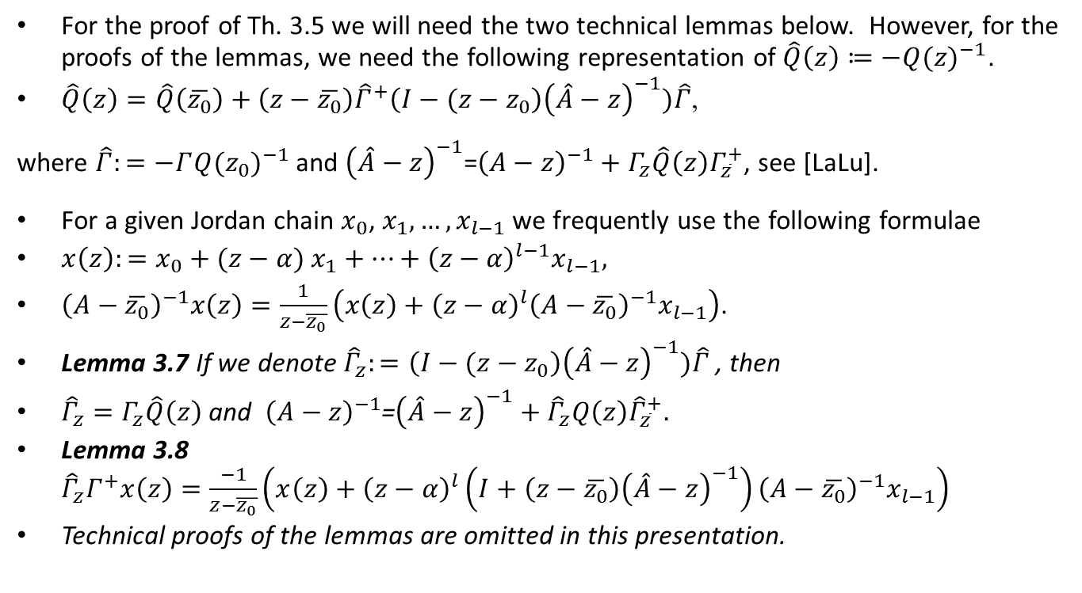
Hint of the proof of Theorem 3.5
For the proof of Th. 3.5 we will need the two technical lemmas below. However, for the proofs of the lemmas, we need the following representation of $\hat{Q}\left(z\right)≔−{Q(z)}^{−1}$.
$\hat{Q}\left(z\right)=\hat{Q}\left(\overline{z_{0}}\right)+\left(z−\overline{z_{0}}\right){\hat{Γ}}^{+}\left(I−(z−z_{0}\right){\left(\hat{A}−z\right)}^{−1})\hat{Γ}$,
where $\hat{Γ}:=−Γ{Q(z_{0})}^{−1}$ and ${\left(\hat{A}−z\right)}^{−1}$=${\left(A−z\right)}^{−1}+Γ_{z}\hat{Q}\left(z\right)Γ_{\overline{z}}^{+}$, see [LaLu].
For a given Jordan chain $x_{0}$, $x_{1},…,x_{l−1}$ we frequently use the following formulae
$x\left(z\right):=x_{0}+(z−α)$ $x_{1}+…+{\left(z−α\right)}^{l−1}x_{l−1},$
${\left(A−\overline{z_{0}}\right)}^{−1}x\left(z\right)=\frac{1}{z−\overline{z_{0}}}\left(x\left(z\right)+{\left(z−α\right)}^{l}{\left(A−\overline{z_{0}}\right)}^{−1}x_{l−1}\right)$.
Lemma 3.7 If we denote ${\hat{Γ}}_{z}:=\left(I−(z−z_{0}\right){\left(\hat{A}−z\right)}^{−1})\hat{Γ}$ , then
${\hat{Γ}}_{z}=Γ_{z}\hat{Q}\left(z\right)$ and ${\left(A−z\right)}^{−1}$=${\left(\hat{A}−z\right)}^{−1}+{\hat{Γ}}_{z}Q\left(z\right){\hat{Γ}}_{\overline{z}}^{+}.$
Lemma 3.8 ${\hat{Γ}}_{z}Γ^{+}x\left(z\right)=\frac{−1}{z−\overline{z_{0}}}\left(x\left(z\right)+{\left(z−α\right)}^{l}\left(I+\left(z−\overline{z_{0}}\right){\left(\hat{A}−z\right)}^{−1}\right){\left(A−\overline{z_{0}}\right)}^{−1}x_{l−1}\right)$
Technical proofs of the lemmas are omitted in this presentation.

Slide 17
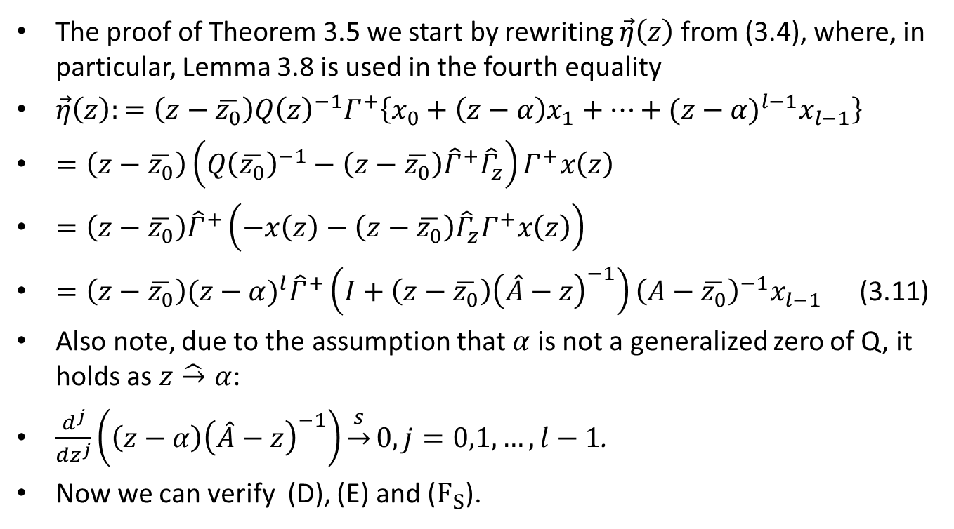
Proof of Theorem 3.5 continuation
The proof of Theorem 3.5 we start by rewriting $\vec{η}\left(z\right)$ from (3.4), where, in particular, Lemma 3.8 is used in the fourth equality
$\vec{η}\left(z\right):=\left(z−\overline{z_{0}}\right){Q\left(z\right)}^{−1}Γ^{+}\left\{x_{0}+\left(z−α\right)x_{1}+…+{(z−α)}^{l−1}x_{l−1}\right\}$
$=\left(z−\overline{z_{0}}\right)\left({Q\left(\overline{z_{0}}\right)}^{−1}−\left(z−\overline{z_{0}}\right){\hat{Γ}}^{+}{\hat{Γ}}_{z}\right)Γ^{+}x\left(z\right)$
$=\left(z−\overline{z_{0}}\right){\hat{Γ}}^{+}\left(−x\left(z\right)−\left(z−\overline{z_{0}}\right){\hat{Γ}}_{z}Γ^{+}x\left(z\right)\right)$
$=\left(z−\overline{z_{0}}\right){(z−α)}^{l}{\hat{Γ}}^{+}\left(I+\left(z−\overline{z_{0}}\right){\left(\hat{A}−z\right)}^{−1}\right){\left(A−\overline{z_{0}}\right)}^{−1}x_{l−1}$ (3.11)
Also note, due to the assumption that $α$ is not a generalized zero of Q, it holds as $z\hat{→}α$:
$\frac{d^{j}}{{dz}^{j}}\left(\left(z−α\right){\left(\hat{A}−z\right)}^{−1}\right)\underset{→}{s}0, j=0,1, …, l−1$.
Now we can verify (D), (E) and ($F_{S}$).

Slide 18
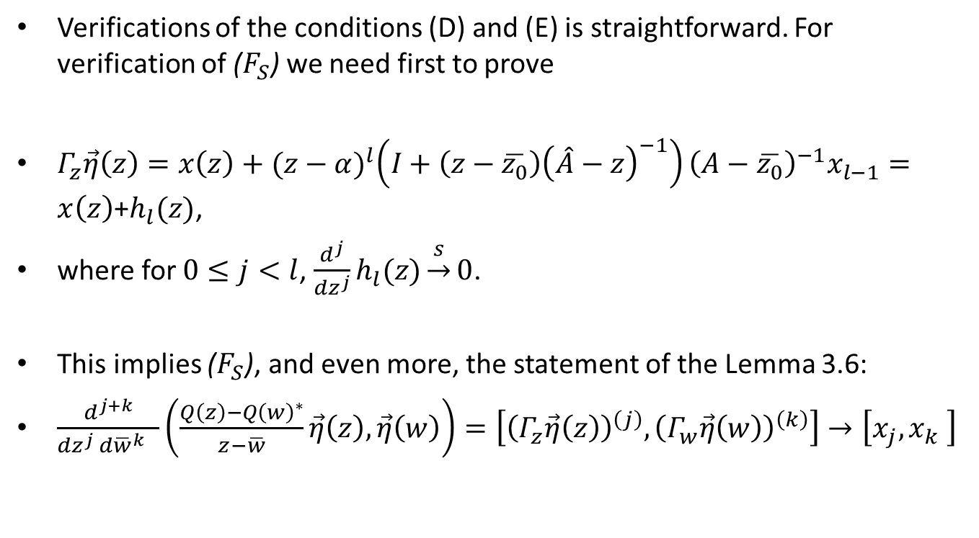

Verification of ($F_{S}$) and Corollary 3.6
Verifications of the conditions (D) and (E) is straightforward. For verification of ($F_{S}$) we need first to prove
$Γ_{z}\vec{η}\left(z\right)=x\left(z\right)+{(z−α)}^{l}\left(I+\left(z−\overline{z_{0}}\right){\left(\hat{A}−z\right)}^{−1}\right){\left(A−\overline{z_{0}}\right)}^{−1}x_{l−1}=x\left(z\right)$+$h_{l}(z)$,
where for $0≤j<l$, $\frac{d^{j}}{{dz}^{j}}h_{l}(z)\underset{→}{s}0$.
This implies ($F_{S}$), and even more, the statement of the Lemma 3.6:
$\frac{d^{j+k}}{{dz}^{j} {d\overline{w}}^{k} }\left(\frac{Q\left(z\right)−{Q\left(w\right)}^{∗}}{z−\overline{w}}\vec{η}\left(z\right),\vec{η}\left(w\right)\right)=\left[{\left(Γ_{z}\vec{η}\left(z\right)\right)}^{\left(j\right)},{\left(Γ_{w}\vec{η}\left(w\right)\right)}^{\left(k\right)}\right]→\left[x_{j},x_{k} \right]$

Slide 19
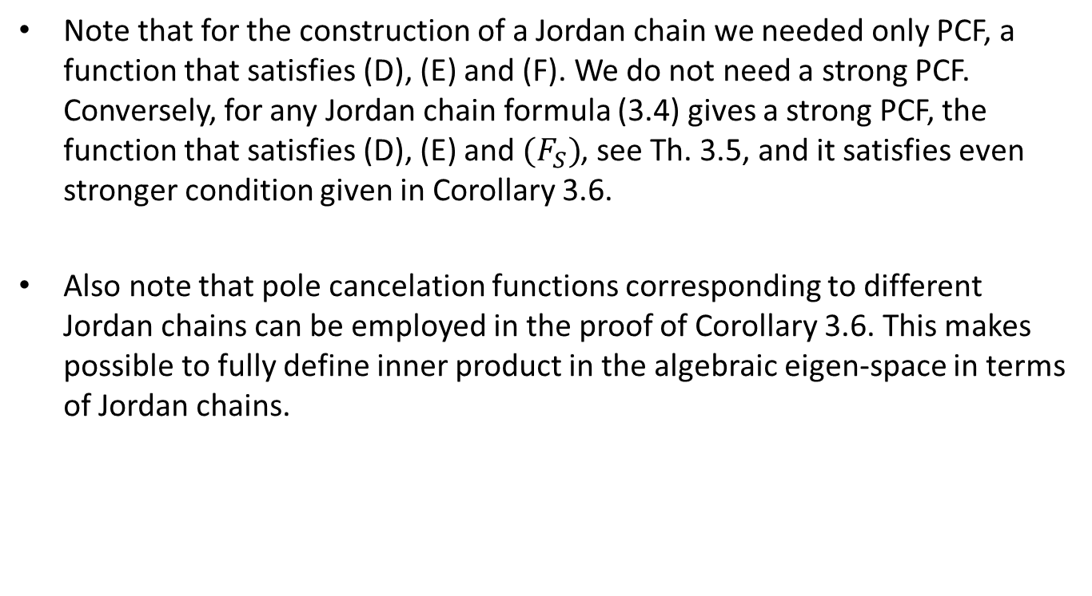
Structure of the algebraic eigen-space
Note that for the construction of a Jordan chain we needed only PCF, a function that satisfies (D), (E) and (F). We do not need a strong PCF. Conversely, for any Jordan chain formula (3.4) gives a strong PCF, the function that satisfies (D), (E) and $(F_{S})$, see Th. 3.5, and it satisfies even stronger condition given in Corollary 3.6.
Also note that pole cancelation functions corresponding to different Jordan chains can be employed in the proof of Corollary 3.6. This makes possible to fully define inner product in the algebraic eigen-space in terms of Jordan chains.

Slide 20
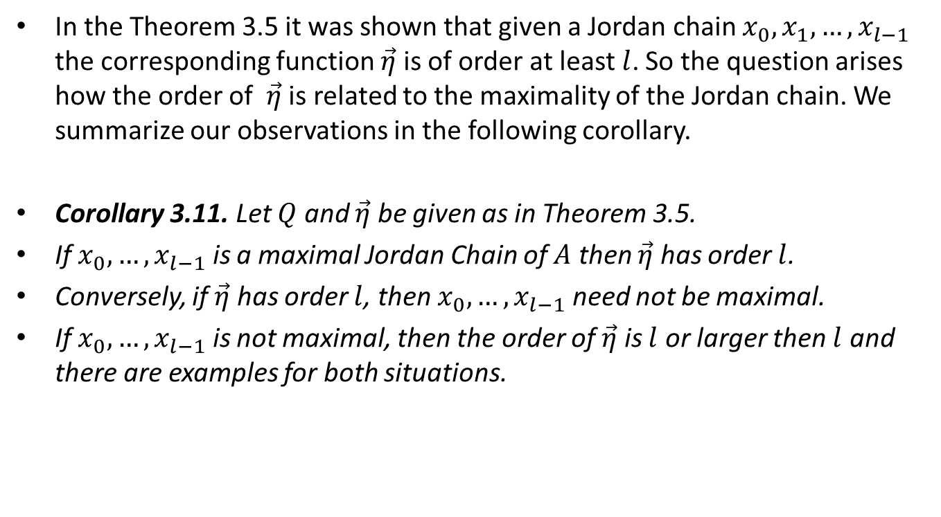
Examples summarized
In the Theorem 3.5 it was shown that given a Jordan chain $x_{0}, x_{1},…,x_{l−1}$ the corresponding function $\vec{η}$ is of order at least $l$. So the question arises how the order of $\vec{η}$ is related to the maximality of the Jordan chain. We summarize our observations in the following corollary.
Corollary 3.11. Let $Q$ and $\vec{η}$ be given as in Theorem 3.5.
If $x_{0}, …,x_{l−1}$ is a maximal Jordan Chain of $A$ then $\vec{η}$ has order $l$.
Conversely, if $\vec{η}$ has order $l$, then $x_{0}, …,x_{l−1}$ need not be maximal.
If $x_{0}, …,x_{l−1}$ is not maximal, then the order of $\vec{η}$ is $l$ or larger then $l$ and there are examples for both situations.

Slide 21
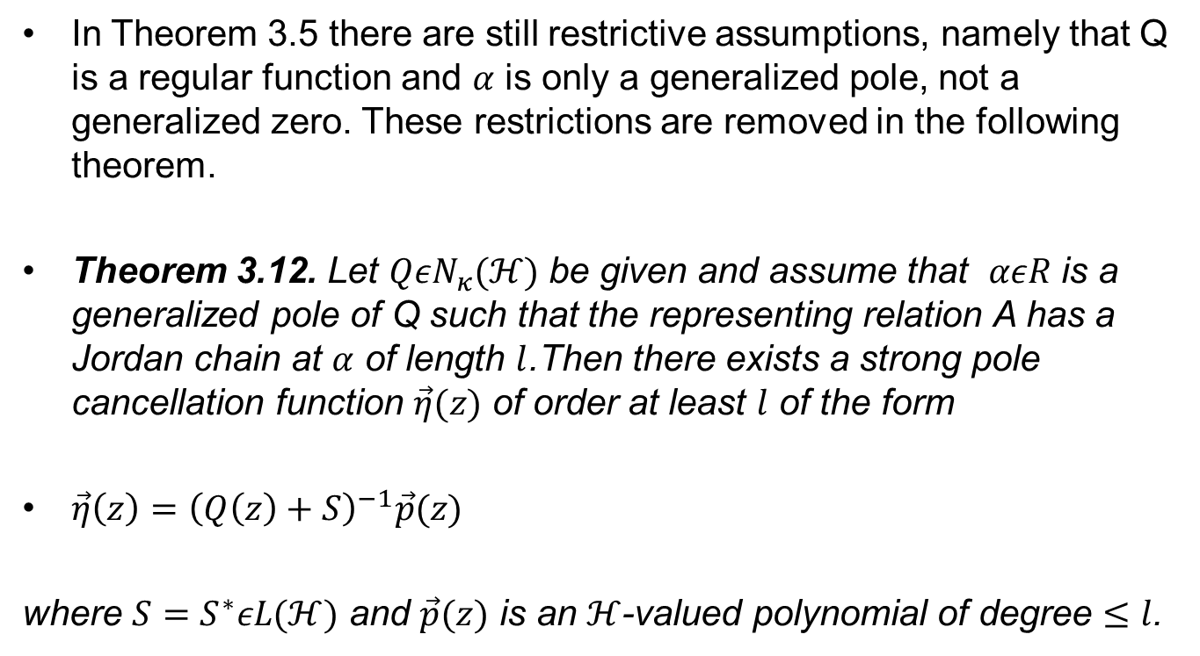
What if a generalized pole is also a generalized zero?
In Theorem 3.5 there are still restrictive assumptions, namely that Q is a regular function and $α$ is only a generalized pole, not a generalized zero. These restrictions are removed in the following theorem.
Theorem 3.12. Let $Q{εN}_{κ}(ℋ)$ be given and assume that $αεR$ is a generalized pole of Q such that the representing relation A has a Jordan chain at $α$ of length $l$.Then there exists a strong pole cancellation function $\vec{η}(z)$ of order at least $l$ of the form
$\vec{η}\left(z\right)={\left(Q\left(z\right)+S\right)}^{−1}\vec{p}(z)$
where $S=S^{∗}εL(ℋ)$ and $\vec{p}(z)$ is an $ℋ$-valued polynomial of degree $≤l$.

Slide 22
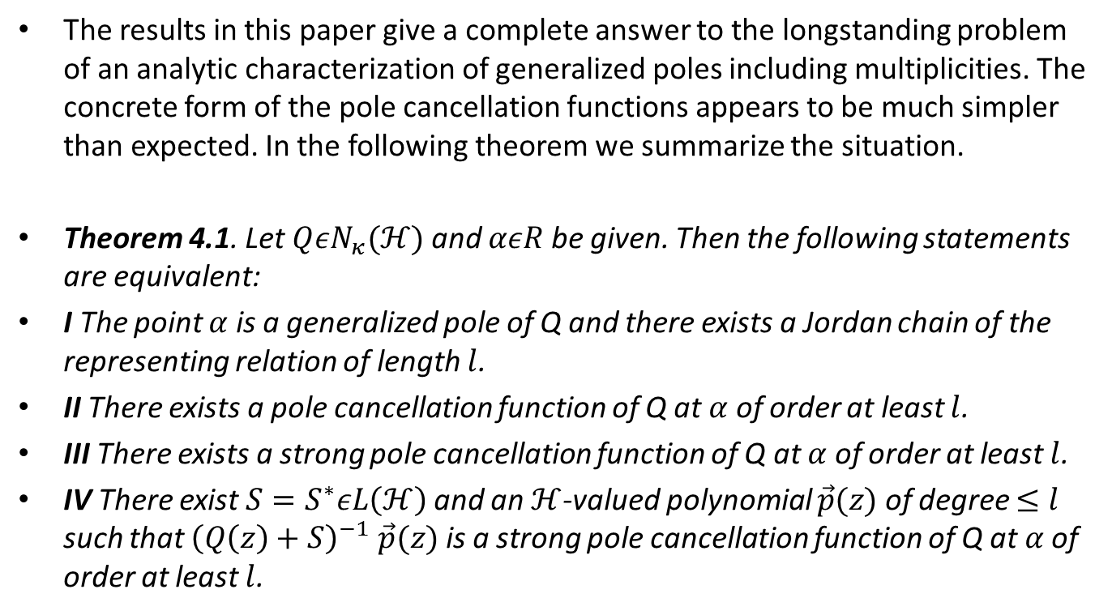
Conclusion
The results in this paper give a complete answer to the longstanding problem of an analytic characterization of generalized poles including multiplicities. The concrete form of the pole cancellation functions appears to be much simpler than expected. In the following theorem we summarize the situation.
Theorem 4.1. Let $Q{εN}_{κ}(ℋ)$ and $αεR$ be given. Then the following statements are equivalent:
I The point $α$ is a generalized pole of Q and there exists a Jordan chain of the representing relation of length $l$.
II There exists a pole cancellation function of Q at $α$ of order at least $l$.
III There exists a strong pole cancellation function of Q at $α$ of order at least $l$.
IV There exist $S=S^{∗}εL\left(ℋ\right)$ and an $ℋ$-valued polynomial $\vec{p}(z)$ of degree $≤l$ such that ${\left(Q\left(z\right)+S\right)}^{−1}$ $\vec{p}(z)$ is a strong pole cancellation function of Q at $α$ of order at least $l$.

Slide 23
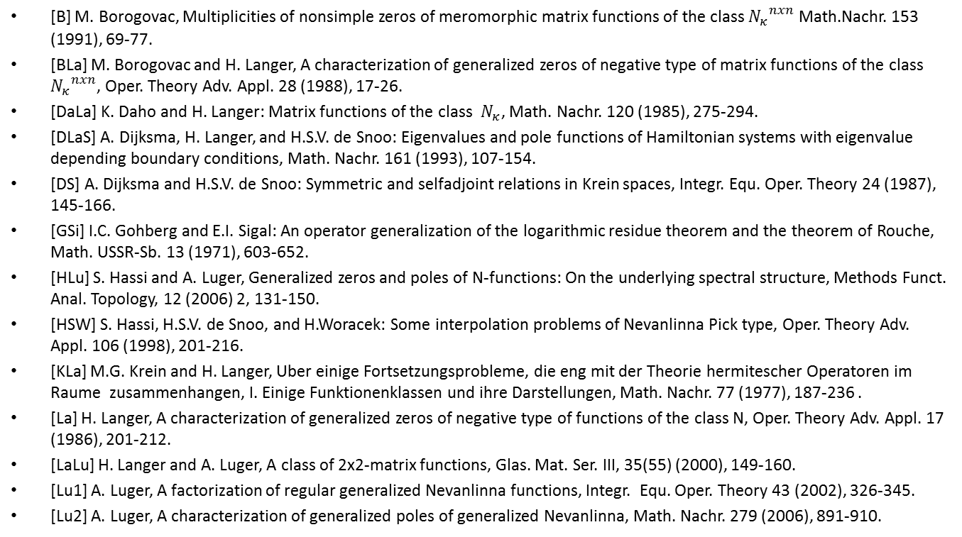
References
[B] M. Borogovac, Multiplicities of nonsimple zeros of meromorphic matrix functions of the class ${N_{κ}}_{}^{nxn}$ Math.Nachr. 153 (1991), 69-77.
[BLa] M. Borogovac and H. Langer, A characterization of generalized zeros of negative type of matrix functions of the class ${N_{κ}}^{nxn}$, Oper. Theory Adv. Appl. 28 (1988), 17-26.
[DaLa] K. Daho and H. Langer: Matrix functions of the class $N_{κ}$, Math. Nachr. 120 (1985), 275-294.
[DLaS] A. Dijksma, H. Langer, and H.S.V. de Snoo: Eigenvalues and pole functions of Hamiltonian systems with eigenvalue depending boundary conditions, Math. Nachr. 161 (1993), 107-154.
[DS] A. Dijksma and H.S.V. de Snoo: Symmetric and selfadjoint relations in Krein spaces, Integr. Equ. Oper. Theory 24 (1987), 145-166.
[GSi] I.C. Gohberg and E.I. Sigal: An operator generalization of the logarithmic residue theorem and the theorem of Rouche, Math. USSR-Sb. 13 (1971), 603-652.
[HLu] S. Hassi and A. Luger, Generalized zeros and poles of N-functions: On the underlying spectral structure, Methods Funct. Anal. Topology, 12 (2006) 2, 131-150.
[HSW] S. Hassi, H.S.V. de Snoo, and H.Woracek: Some interpolation problems of Nevanlinna Pick type, Oper. Theory Adv. Appl. 106 (1998), 201-216.
[KLa] M.G. Krein and H. Langer, Uber einige Fortsetzungsprobleme, die eng mit der Theorie hermitescher Operatoren im Raume zusammenhangen, I. Einige Funktionenklassen und ihre Darstellungen, Math. Nachr. 77 (1977), 187-236 .
[La] H. Langer, A characterization of generalized zeros of negative type of functions of the class N, Oper. Theory Adv. Appl. 17 (1986), 201-212.
[LaLu] H. Langer and A. Luger, A class of 2x2-matrix functions, Glas. Mat. Ser. III, 35(55) (2000), 149-160.
[Lu1] A. Luger, A factorization of regular generalized Nevanlinna functions, Integr. Equ. Oper. Theory 43 (2002), 326-345.
[Lu2] A. Luger, A characterization of generalized poles of generalized Nevanlinna, Math. Nachr. 279 (2006), 891-910.

